Slide 1
Volumetric Analysis
Concentration of Solutions

Slide 2
Concentration of Solutions
Remember:
Solution – A mixture of a solute and a solvent
Solvent – The liquid in which the solute is dissolved
Solute – The substance that is dissolved in the solvent

Slide 3
Dilute Solution – contains a small amount of solute per solvent
Concentrated Solution – contains a large amount of solute per solvent
Concentration – the amount of solute that is dissolved in a specific volume of solution

Slide 4
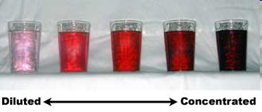
In some solutions concentration can be indicated by colour intensity.
The less intense the colour – dilute solution
The more intense the colour – concentrated solution

Slide 5
% Weight per weight (% w/w)
Mass per 100g
Example:
12% w/w means that there is 12g per 100g
Concentrated acid/base
% iron in iron tablets
Q: In a 125g solution, there is 22.5g of HCl. Express this concentration as %w/w.
A: 22.5 ÷ 125 x 100 = 18% w/w

Slide 6
% Weight per volume (%w/v)
Mass per 100cm³
Example:
30% w/v means that there is 30g per 100cm³
Saline solution – 0.91% w/v NaCl
Q: A 1.4% solution of CaCl is required for an experiment. If you need 250cm³ of this solution, how much CaCl should be weighed out?
A: 1.4 x 2.5 = 3.5g

Slide 7
% Volume per volume (%v/v)
Volume per 100cm³
Example:
9% v/v contains 9cm³ per 100cm³
Concentration of alcohol in beverages
Q: Wine contains 14% v/v. If a person consumes a 40cm³ glass of wine, how much alcohol do they consume?
A: 14 ÷ 100 x 40 = 5.6cm³

Slide 8
Parts per million (ppm)
Number of milligrams per litre
1 ppm = 1mg per L (remember 1000mg = 1g)
Used for very dilute solutions
Example:
Concentrations of pollutants in water
Q: A sample of water is found to contain 0.003g of lead in a 250cm³ sample. What is the concentration of lead in ppm?
A: 0.003 x 4 x 1000 = 12ppm

Slide 9
Molarity
Number of moles per litre
Most common method of expressing concentration
1M = 1 mol/litre = 1 mol l⁻¹
A 1 Molar solution contains one mole of solute dissolved in 1 litre of solution

Slide 10
Q: A solution is labelled 0.15M HCl. How many grams of HCl are present in 1 litre?
A: M_{r} of HCl = 36.5g
1M solution contains 36.5g / l
0.15M solution = 36.5 x 0.15 = 5.475g
Q: A solution contains 4.9g H₂SO₄ in 100cm³.
Calculate the concentration in mol/l.
A: M_{r} of H₂SO₄ = 98g
4.9 ÷ 98 = 0.05mol in 100cm³
0.05 x 10 = 0.5mol/l

Slide 11
Effect of Dilution on Concentration
When a solution is diluted, more solvent is added.
The quantity of solute remains unchanged.

Slide 12
To calculate the effect of dilution on concentration:
V_{dil} x M_{dil} = V_{conc} x M_{conc}
1000 1000

Slide 13
Q: What volume of 18M HCl would be required to prepare 250cm³ of 0.5M HCl?
A: V_{dil} x M_{dil} = V_{conc} x M_{conc}
1000 1000
250 x 0.5 = V_{conc} x 18
1000 1000
250 x 0.5 = V_{conc}
18
6.94cm³ = V_{conc}

Slide 14
Standard Solutions
A standard solution is a solution of accurately known concentration
It is prepared by dissolving an exact mass of solute in a solvent producing a definite known volume of the solution

Slide 15
Primary Standard
Pure and stable state
Soluble in water
Anhydrous (not hydrated)
No water loss (no efflorescence)
Not deliquescent (solid that turns into liquid)
Not hygroscopic (absorbs moisture from air)
Does not sublime (solid turns directly onto gas)
High Molecular Mass
Used to produce a solution of accurately known concentration

Slide 16
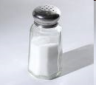
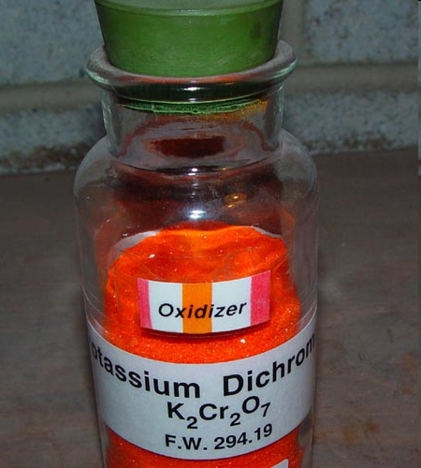
Examples of Primary Standards
Sodium Chloride
Anhydrous Sodium Carbonate
Potassium Dichromate

Slide 17
Common substances that are not primary standards include:
Sulfuric acid – absorbs water vapour from the air.
Sodium hydroxide – absorbs water vapour from the air.
Iodine – sublimes.

