Slide 1
Atomic Structure/ Sub-particles- Definitions Mass Spectrometer

Slide 2
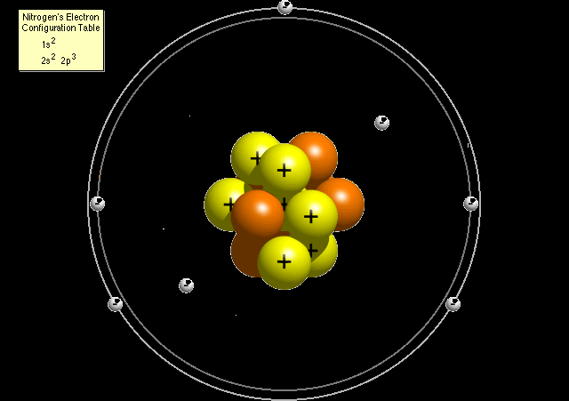
Proton
Protons are positively charged particles found within atomic nucleus

Slide 3
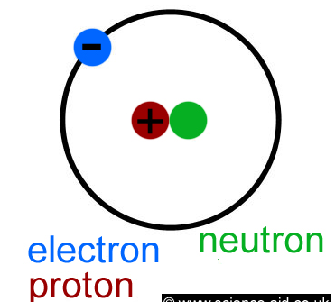

Slide 5
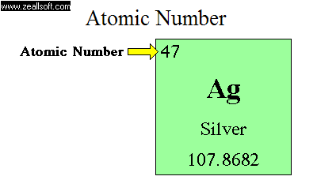
Atomic number
Also called proton number, this is the number of protons the atom has

Slide 6
The Number of Electrons
Atoms must have equal numbers of protons and electrons. In our example, an atom of krypton must contain 36 electrons since it contains 36 protons.

Slide 7
Mass number
Mass Number = (Number of Protons) + (Number of Neutrons)

Slide 8
Isotope
Atoms that have the same number of protons but different numbers of neutrons are called isotopes

Slide 9
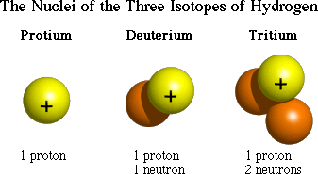

Slide 10
Hydrogen isotopes
The element hydrogen for example, has three commonly known isotopes: protium, deuterium and tritium

Slide 11
Deuterium
an atom of deuterium consists of one proton one neutron and one electron

Slide 12
Tritium
An atom of tritium consists of one proton two neutrons and one electrons

Slide 13
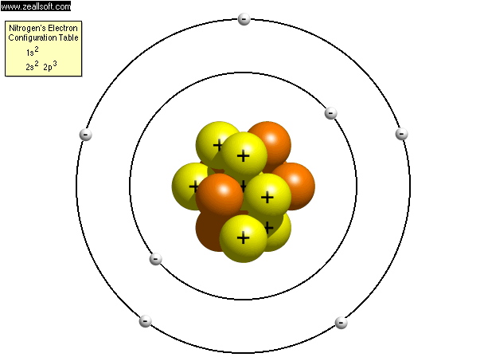

Slide 14
Relative Atomic Mass
The relative atomic mass of an element the average mass of one of the element's atoms –taking the abundancies of the isotopes into account- relative to the mass of 1/12 of an atom of Carbon 12.

Slide 15
Calculations!!!! What I need to know
Calculation of approximate relative atomic masses from abundance of isotopes of given mass number (e.g. Calculation of approximate relative atomic mass of chlorine).

Slide 16
Chlorine
Chlorine-35 and Chlorine-37 are both isotopes of chlorine

Slide 17
Relative mass of chlorine
Chlorine consists of roughly 75% Chlorine-35 and roughly 25% Chlorine-37.
Mass = (75 x 35) + (37 x 25) / 100
= 35.5

Slide 18
We take an average of the two figures The relative atomic mass of chlorine is usually quoted as 35.5

Slide 19
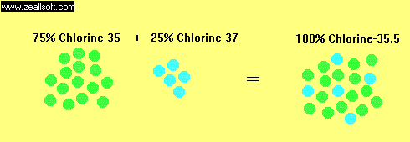

Slide 20
Mass Spectrometer –What I need to know??
Use of the mass spectrometer in determining relative atomic mass.
Fundamental processes that occur in a mass spectrometer:
vaporisation of substance,
production of positive ions,
acceleration, separation,
detection (mathematical
treatment excluded).

Slide 21
THE MASS SPECTROMETER
Principle: positively charged particles (ions) are separated on the basis of their relative atomic masses when moving through a magnetic field
Atoms can be deflected by magnetic fields - provided the atom is first turned into an ion.

Slide 22
Stage 1 :
A: vaporisation-sample is heated until it is vapourised into a gas
B: Ionisation The atom is ionised by knocking one or more electrons off to give a positive ion. This is done using electron beams

Slide 23
Stage 2: Acceleration
The ions are accelerated using electric plates so that they all have the same high speed

Slide 24
Stage 3: Deflection
The ions are then deflected by a magnetic field according to their masses. The lighter they are, the more they are deflected. In this way different masses are separated and quantities identified

Slide 25
Stage 4: Detection
The beam of ions passing through the machine is detected electrically. The proportions of each isotope can be measured.

Slide 26
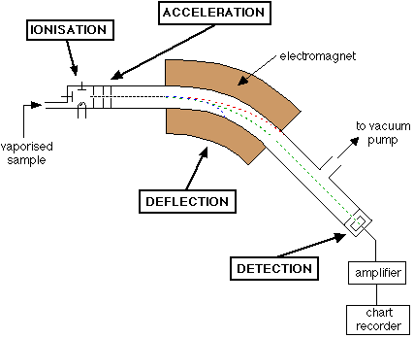

Slide 27
