Slide 1
Essential to know
Sulphates [SO4²⁻ ]
Sulphites [SO3²⁻]
Hydroxides [OH⁻¹]
Carbonates [CO3²⁻]
Hydrogencarbonates [HCO3¹⁻]
Nitrates [NO3¹⁻]
Of the first 36 elements – excluding the d-block elements – where they exist

Slide 2
Atomic number is a series
Atomic number tells number of protons
Number of protons determines the element
Atomic Mass is about twice atomic number
Difference caused by neutrons
Number of neutrons calculated by atomic mass – atomic number

Slide 3
Number of electrons = number of protons = atomic number Electrons fill shells from inside out
2,8,8,(2) is maximum – brackets because not full
If an outer shell is full the atom is very stable
Usually 8 electrons fill the outer shell – Octet rule
Helium is one exception

Slide 4
Octet Rule All atoms are trying to get structure of nearest Noble Gas i.e. eight electrons in their outer shell and thus stability

Slide 5
The octet rule is a simple chemical rule of thumb
Octet Rule says atoms with 8 electrons in their outer shell are stable
Atoms tend to combine in such a way that they each have eight electrons in their valence shells, giving them the same electron configuration as a noble gas.
The nearest Nobel gas

Slide 6
The rule applies to the main-group elements, especially carbon, nitrogen, oxygen, the halogens, and also to metals such as sodium or magnesium.
In simple terms, molecules or ions tend to be most stable when the outermost electron shells of their constituent atoms contain 8 electrons.

Slide 7
Noble Gases
group of elements were discovered at the end of the 18th century
They were un-reactive so they were called the “Noble Gases”
Later they were called “Inert Gases” as they did not react and it sounded more scientific.
Now called “Noble” again because they do react under extreme conditions
Atoms with a full outer shell of electrons are very stable

Slide 8
Limitations
Doesn’t allow for
H, He or Li [stable with 2 e⁻ in their outer shells] - Duet Rule
Transition elements - 18 electron rule
BF₃ which only has 6 e⁻ in its outer shell

Slide 9
How can atoms get a full outer shell?
Give away electrons
Take in electrons
Share electrons
Don’t bother getting a full outer shell at all – (Rare but does happen [BF₃])

Slide 10
2.3.1 Covalent Bonding

Slide 11
General Rules
Involves a sharing of electrons
Electrons are shared in pairs
In each shared pair one electron comes from each atom
This type of bond occurs between elements of Groups IV, V, VI and VII
If there is a choice between ionic and covalent - covalent is preferred
There are exceptions

Slide 12
Hydrogen
H₂
1+
1+
—
Represents a shared pair of electrons.
Called a Single Bond
H — H

Slide 13
Hydrogen - Alternative View
H
H
H — H
H₂

Slide 14
Chlorine
Only draw the outer shell electrons
Cl
Cl
Cl — Cl

Slide 15
Chlorine – Alternative View
Only draw the outer shell electrons
Cl
Cl
Cl — Cl

Slide 16
Oxygen
O
O
O
O
O = O
O₂
Two pairs of electrons shared called a Double Bond

Slide 17
Oxygen – Alternative View
O
O
O = O
O₂

Slide 18
Nitrogen
N
N
N ≡ N
N₂
Three pairs of electrons shared called a Triple Bond

Slide 19
Nitrogen – Alternative View
N
N
N ≡ N
N₂

Slide 20
Methane
H
CH₄
H
C
H
H
C
H
H
H
H
4 single C- H Bonds

Slide 21
Ozone O₃
O
O
O — O
O
O

Slide 22
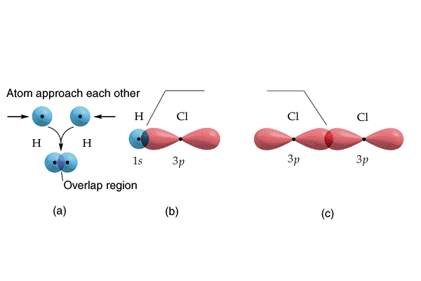
Overlap of Orbitals

Slide 23
Multiple Bonds
Everything we have talked about so far has only dealt with what we call sigma bonds
Sigma bond (σ) → A bond where the line of electron density is concentrated symmetrically along the line connecting the two atoms.

Slide 24
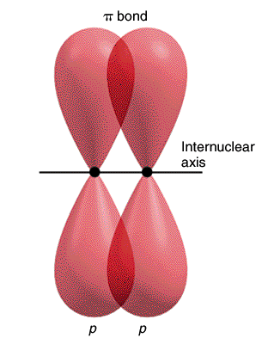
Pi bond (π) → A bond where the overlapping regions exist above and below the internuclear axis (with a nodal plane along the internuclear axis).

Slide 25
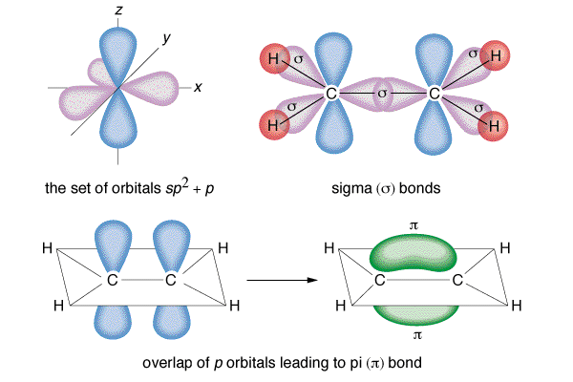
Example: H₂C=CH₂

Slide 26
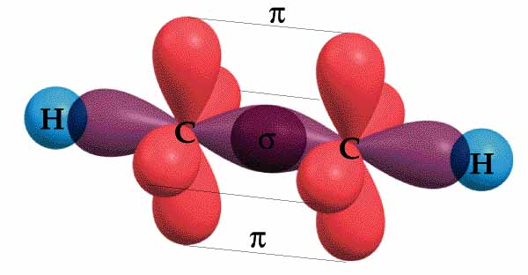
Example: HC≡CH

Slide 27
2.4.1 Electronegativity

Slide 28
Is the relative attraction that an atom in a molecule has for the shared pair of electrons in a covalent bond.
In a bond between two identical atoms the pair of electrons are shared equally
chemists have found that in many bonds the pair of electrons are attracted to one of the atoms more than to the other.

Slide 29
Hydrogen and Chlorine
Electrons attracted to chlorine more than to hydrogen [ bigger , but more +ve nucleus]
therefore the electrons spend more time near the chlorine than near the hydrogen
this gives the chlorine a slightly negative charge [δ- delta minus]
it gives the hydrogen a slightly positive charge [δ+ delta plus]

Slide 30
H
Cl

Slide 31
Linus Pauling measured the electronegativity of each element and put them in a table
Noble gases are not in this table because they do not form bonds
H
Cl
δ+
δ –

Slide 32
Differences and Bond Type
Difference 0 to 0.4
[Pure] Covalent Bond
Difference > 0.4 but < 1.7
Polar Covalent Bond
Difference is = or > 1.7 then
Ionic Bond

Slide 33
Trends in Electronegativity
Across a period
Goes up
Bigger nuclear charge –
Smaller atomic radius distance from nucleus
Actually closer as diameter of atom gets smaller –

Slide 34
Trends in electronegativity
Down a Group
Goes down
Bigger nuclear charge
But! But! But! But!
Increased Atomic Radius - electron is much further from nucleus
Increased shielding by more inner electron shells

Slide 35
Define electronegativity [3]
Who invented the term? [1]
What happens to it as you go across a period. Explain.[3]
What happens to it as you go down group? Explain. [3]
Give three classes of bond and electronegativity associated with each [6]
How can you show that a molecule is polar. [4]
What group of elements is not present in the table of electronegativity. Why? [2]
Total = 22

Slide 36
Define electronegativity [3] measure of the attraction of an atom / for an electron / in a shared pair
Who invented the term? [1] Linus Pauling
What happens to it as you go across a period. Explain.[3] Goes up / bigger nuclear charge / same shell or decreasing atomic radius
What happens to it as you go down group? Explain. [3] Goes down / further from nucleus / more shielding
Give three classes of bond and electronegativity associated with each [6] 0 - 0.4 / pure covalent / 0.4 to 1.7 / polar covalent / over 1.7 / ionic
How can you show that a molecule is polar. [4] Rub pen / pour stream past it / polar bends / non-polar does not bend.
What group of elements is not present in the table of electronegativities. Why? [2] Noble Gases / don’t bond
Total = 22

Slide 37
2.1.3.2 Polar Molecules

Slide 38
H - H
is a pure covalent bond
The electrons are shared equally between the 2 atoms – they have the same electronegativity
Electronegativity - is a measure of the attractiveness of an atom for electrons in a shared pair (covalent bond)
molecule is non-polar
the centre of positive and negative charges are in the same place

Slide 39
H - Cl
electronegativities 2.1 3.0
Cl attracts shared electrons more than H
therefore it is slightly negative and H is therefore slightly positive
Difference is 0.9
^{δ+} H - Cl ^{δ-}
this is a polar covalent bond
and the molecule is also polar

Slide 40
Demonstrating Polarity

Slide 41
To show if a compound [usually a liquid] is polar
Pour it from a burette past a charged rod
[a pen rubbed vigorously on a woollen pullover is an easy way of doing this.]

Slide 42
Non-Polar molecules
Polar molecules
If the liquid is not polar it will pass the rod un-deflected
The stream will be deflected if it is polar
If the charge of the rod is reversed the stream still bends – opposite end of molecule is attracted
Charged Rod

Slide 43
Are all molecules with polar bonds polar?
Let us look at a few examples and see.

Slide 44
_{δ-}
_{δ-}
^{δ+}
—
—
^{δ+}
Centre of
-ve charge
O
H
O
H
—
—
H
H
^{δ+}
^{δ+}
Centre of positive charge
Centre of
negative charge
Centre of +ve charge
H₂O – What shape is it?
Could be linear
or angular
If linear it will be non polar because the centre of + and – would be in the O atom
If it is angular
As electron pair repulsion theory suggests
it will be polar
It is deflected by a charged rod so it is polar

Slide 45
δ-
δ-
δ-
Cl - Be - Cl
electronegativities 3.0 1.5 3.0
Cl is δ- Be is δ+
Bonds are polar covalent
Centre of + charge is in Be
Centre of -ve charge is half way between Cl’s i.e.in the Be atom
Charges are not separated therefore the molecule is non-polar
It would flow un-deflected past a charged rod

Slide 46
Other molecular shapes
NH3 is pyramidal in shape and is polar and because the centres of positive and negative charges are not in the same place
While BF3 is planar and therefore non-polar because the centre of positive and negative charges are in the same place
N
Centre of
negative charge
F
B
F
H
H
F
N
Centre of positive charge
Centre of positive charge
Centre of
negative charge

Slide 47
Carbon dioxide is non-polar. What shape is it?
O = C = O
It is linear because this is the only conformation that can put the centres of positive and negative charges in the same place.
We will deal with this topic [molecular shapes] in more detail in another lesson
C
= O
= O
Centre of positive charge
Centre of
negative charge
Centre of
negative charge
Centre of positive charge

Slide 48
If a polar molecule is placed in a charged field it will turn
^{δ+} H - Cl ^{δ-}
Before switched on

Slide 49
-
^{δ+} H - Cl ^{δ-}
+
After switched on

Slide 50
-
^{δ+} H - Cl ^{δ-}
+
After switched on

Slide 51
-
^{δ+} H - Cl ^{δ-}
+
After switched on

Slide 52
-
^{δ+} H - Cl ^{δ-}
+
After switched on

Slide 53
-
^{δ+} H - Cl ^{δ-}
+
After switched on

Slide 54
-
^{δ+} H - Cl ^{δ-}
+
After switched on

Slide 55
-
^{δ+} H - Cl ^{δ-}
+
After switched on

Slide 56
Type of bond
[Pure] Covalent
Electronegativities differ by less than 0.4
Polar Covalent
Electronegativity difference greater than 0.4 but less than 1.7
Ionic
Electronegativity difference greater than 1.7

Slide 57
2.2.1
Ionic Bonding

Slide 58
Ar
Protons
18
18+
40
Electrons
18
18 -
Overall Charge
0
18
ATOM
Noble Gas -
Also Ne, He, Xe, Kr, Rn
Stable or Unreactive
18+
Full outer shell
All atoms want to be like this i.e. have a full outer shell - Octet Rule

Slide 59
Na
23
Protons
11
11+
Electrons
11
11-
11
Overall
0
ATOM
One electron in outer shell
Wants to get a full outer shell
11+
To have the same pattern as a Noble Gas
Loses electron from outer shell

Slide 60
Na
23
Protons
11
11+
Electrons
11
11-
11
Overall
0
11+

Slide 61
Protons
11
11+
Na⁺
Electrons
10
10-
Overall
1+
ION
Full outer shell
Same pattern as neon
11+
Stable
Now has a + charge
Called an ION

Slide 62
Where has the electron gone?

Slide 63
Cl
35
Protons
17
= 17+
Electrons
17
= 17 -
17
Overall
= 0
ATOM
7 electrons in outer shell
Wants to get a full outer shell
17+
Takes an electron into its outer shell

Slide 64
Protons
17
17+
Cl⁻
Electrons
18
18 -
Overall
1 -
ION
Full outer shell
Same pattern as Argon
17+
Stable
Now has a - charge
Called an ION

Slide 65
Unlike charges attract
Na⁺
Cl⁻
Na⁺
Cl⁻

Slide 66
Summary
Sodium atoms lose an electron to become sodium ions
Sodium ions have a +ve charge
Chlorine atoms gain an electron to become Chloride ions
Chloride ions have a − ve charge
Opposite charges attract so the Na⁺ and Cl⁻ come together and stick to each other
This is called an ionic bond

Slide 67
General Points
Ionic Bonding involves a transfer of electrons
It happens when the difference in electronegativity between atoms > 1.7
Metals lose electrons to form positive ions
They gain one plus charge for each electron lost
Non-metals gain electrons to form negative ions
They gain one minus charge for each electron gained
Total electron loss must equal electron gain

Slide 68
Keeping Track of Electrons
Atoms in the same group [column]
Have the same outer electron configuration.
Have the same valence electrons.
Easily found by looking up the group number on the periodic table.
Group 2A - Be, Mg, Ca, etc.-
2 valence electrons

Slide 69
General Points
Group I lose 1 e- to become M⁺
Group II lose 2 e- to become M²⁺
Group III lose 3 e- to become M³⁺
Group V gain 3 e- to become X³⁻
Group VI gain 2 e- to become X²⁻
Group VII gain 1 e- to become X⁻
There are exceptions

Slide 70
Group I with Group VII
M
M⁺¹
X
X⁻¹
Formula MX

Slide 71
Group II with Group VI
Be
Mg
Ca
Sr
Ba
Ra
O
S
Se
Te
Po
M
M²⁺
X
X²⁻
Formula MX

Slide 72
Group III with Group V
B
Al
Ga
In
Tl
M
M³⁺
X
X³⁻
N
P
As
Sb
Bi
Formula MX

Slide 73
Group II with Group VII
X
Be
Mg
Ca
Sr
Ba
Ra
X¹⁻
M
M²⁺
F
Cl
Br
I
At
X
X¹⁻
Formula MX₂

Slide 74
Group III with Group VII
X
X¹⁻
B
Al
Ga
In
Tl
F
Cl
Br
I
At
M
M³⁺
X
X¹⁻
X
X¹⁻
Formula MX₃

Slide 75
Group II with Group VI
Be
Mg
Ca
Sr
Ba
Ra
M
M⁺
O
S
Se
Te
Po
X
X²⁻
M
M⁺
Formula M₂X

Slide 76
Group I with Group V
M
Li
Na
K
Rb
Cs
Fr
M⁺
N
P
As
Sb
Bi
X
X³⁻
M
M⁺
M
M⁺
Formula M₃X

Slide 77
Group III with Group VII
M
M³⁺
X
X²⁻
B
Al
Ga
In
Tl
F
Cl
Br
I
At
X
X²⁻
M
M³⁺
X
X²⁻
Formula M₂X₃

Slide 78
Group II with Group V
M
M²⁺
Be
Mg
Ca
Sr
Ba
Ra
N
P
As
Sb
Bi
X
X³⁻
M
M²⁺
X
X³⁻
M
M²⁺
Formula M₃X₂

Slide 79
Examples
Aluminium :oxygen
Magnesium :nitrogen
Barium: Arsenic
Aluminium :Iodine
Gallium :Sulphur
Barium :Oxygen
Sodium :Fluorine
Draw diagrams – outer shell only required
Show electron movement with arrows
Show atoms with charge and number
Write formula [without charges] and name

Slide 80
2.4.2 Properties of Ionic Compounds

Slide 81
Have high melting points
Have high boiling points
Have a crystalline form [in general]
Brittle
Insulators when solid
Conduct when molten or in solution
Conduct with Electrolysis
Electrolysis is a chemical reaction caused by the passage of an electric current [DC] through a liquid called the electrolyte.

Slide 83
Tend to be soluble in water in -
like dissolves like I.e ionic liquids dissolve ionic solids; covalent liquids dissolve covalent liquid

